Slide 1

An introduction to MongoDB

Slide 2
Agenda
SQL vs NoSQL
Introduction of MongoDB
MongoDB Features
Replication/ High Availability
Sharding/ Scaling

Slide 3
SQL vs NoSQL
NoSQL (often interpreted as Not only SQL) database
It provides a mechanism for storage and retrieval of data that is modeled in means other than the tabular relations used in relational databases.
SQL | NoSQL
Relational Database Management System (RDBMS) | Non-relational or distributed database system.
These databases have fixed or static or predefined schema | They have dynamic schema
These databases are best suited for complex queries | These databases are not so good for complex queries
Vertically Scalable | Horizontally scalable
Follows ACID property | Follows BASE property

Slide 4
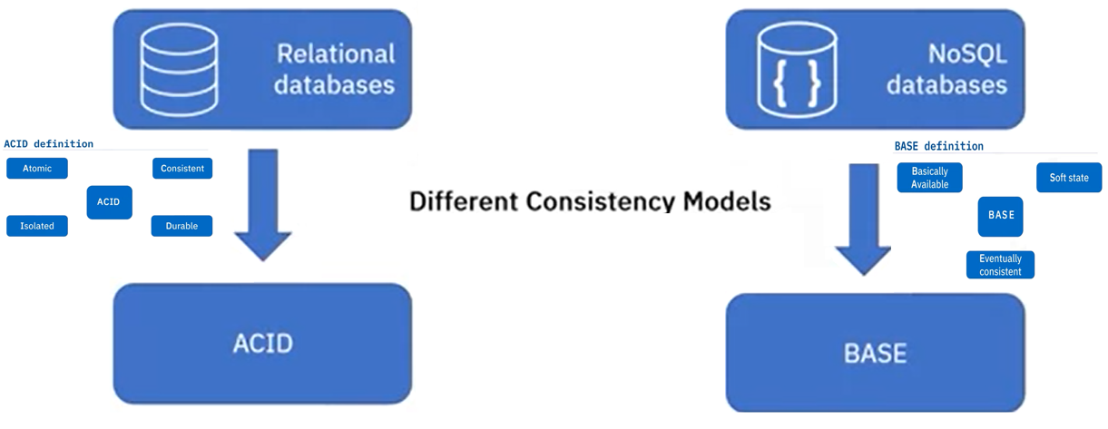
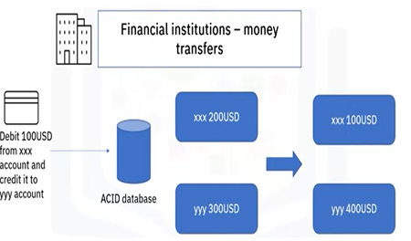
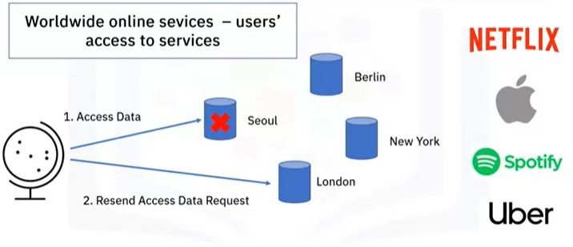
SQL vs NoSQL

Slide 5
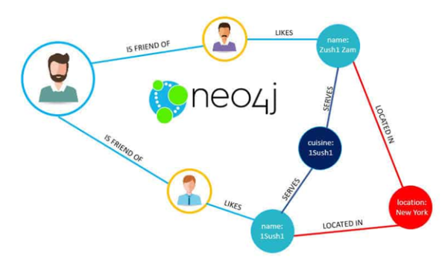


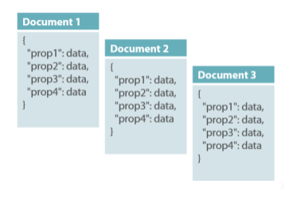


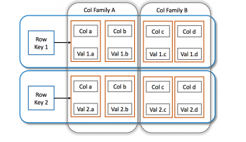


NoSQL Types
Graph database
Document-oriented
Column family

Slide 6
MongoDB is an open source, document-oriented database designed with both scalability and developer agility in mind.
Instead of storing your data in tables and rows as you would with a relational database, in MongoDB you store JSON-like documents with dynamic schemas(schema-free, schema less).
{
"_id" : ObjectId("5114e0bd42…"),
“FirstName" : "John",
“LastName" : "Doe",
“Age" : 39,
“Interests" : [ "Reading", "Mountain Biking ]
“Favorites": {
"color": "Blue",
"sport": "Soccer“
}
}

Slide 7
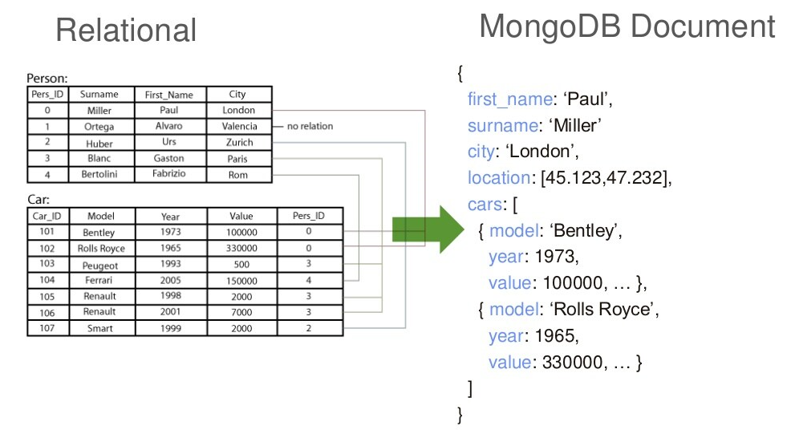
MongoDB is Easy to Use

Slide 8
Scheme Free
RDBMS vs MongoDB
MongoDB does not need any pre-defined data schema
Every document could have different data!
RDBMS |  | MongoDB
Database |  | Database
Table |  | Collection
Row |  | Document (JSON, BSON)
Column |  | Field
Index |  | Index
Join |  | Embedded Document
Partition |  | Shard
{name: “will”,
eyes: “blue”,
birthplace: “NY”,
aliases: [“bill”, “ben”],
loc: [32.7, 63.4],
boss: ”ben”}
{name: “jeff”,
eyes: “blue”,
loc: [40.7, 73.4],
boss: “ben”}
{name: “brendan”,
boss: “will”}
{name: “matt”,
weight:60,
height: 72,
loc: [44.6, 71.3]}
{name: “ben”,
age:25}

Slide 9
Document-Oriented storage
Full Index Support
Replication & High Availability
Auto-Sharding
Aggregation
MongoDB Atlas
Various APIs
JavaScript, Python, Ruby, Perl, Java, Java, Scala, C#, C++, Haskell, Erlang
Community

Slide 10
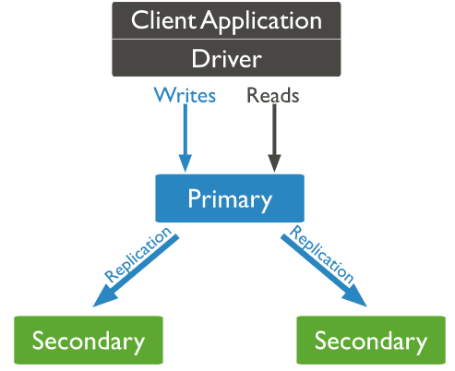
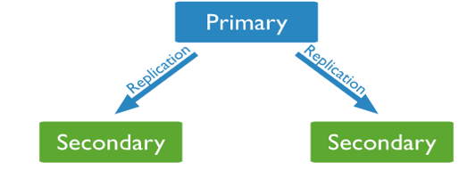
Replication provides redundancy and increases data availability.
With multiple copies of data on different database servers, replication provides a level of fault tolerance against the loss of a single database server.
Copy of database
Copy of database

Slide 11
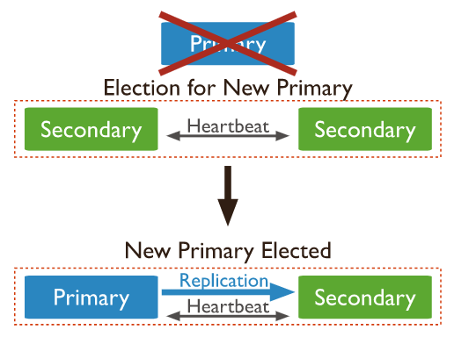
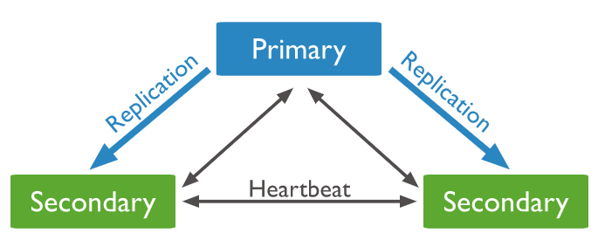

Slide 12
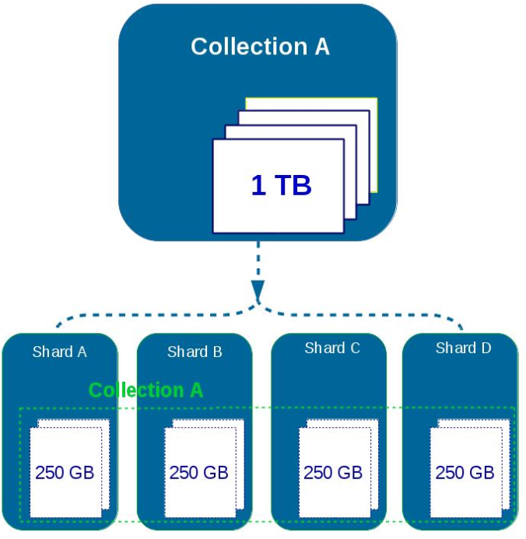
Sharding is a method for distributing data across multiple machines.
MongoDB uses sharding to support deployments with very large data sets and high throughput operations.

Slide 13
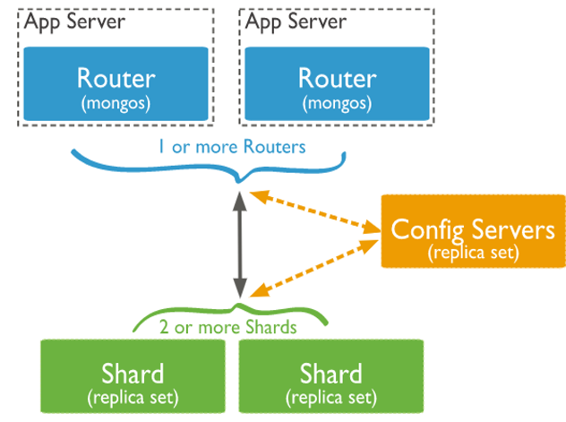
Shard is a Mongo instance to handle a subset of original data.
Mongos is a query router to shards.
Config Server is a Mongo instance which stores metadata information and configuration details of cluster.

Slide 14
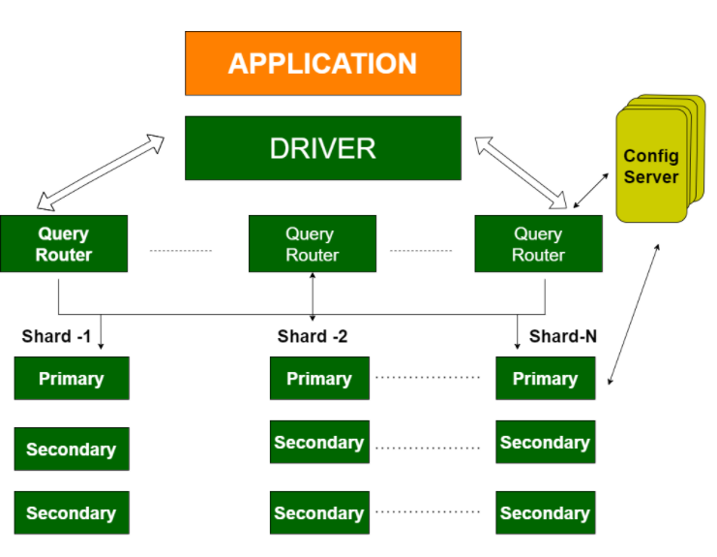
Replication Split data sets across multiple data nodes for high availability.
Sharding scale up/down horizontally when it is required for high throughput

Slide 15
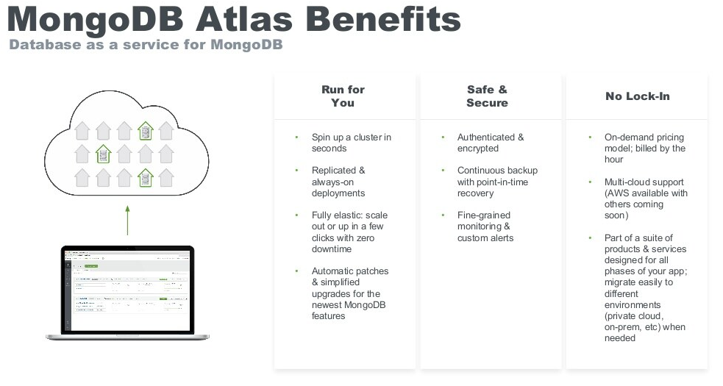

Slide 16
What is Mongo DB
MongoDB is a cross-platform, document oriented database that provides
High performance.
High availability.
Easy scalability.
MongoDB works on concept of collection and document.

Slide 17
Why Mongo DB?
All the modern applications deals with huge data.
Development with ease is possible with mongo DB.
Flexibility in deployment.
Rich Queries.
Older database systems may not be compatible with the design.
And it’s a document oriented storage:- Data is stored in the form of JSON Style.

Slide 18
Mongo DB architecture
Architecture : -
Database
Document
Container

Slide 19
Document(JSON) Structure
[
{
"Name": "Tom",
"Age": 30,
"Role": "Student",
"University": "CU",
}
{
"Name": “Sam",
"Age": 32,
"Role": "Student",
"University": “OU",
}
]
The document has simple structure and very easy to understand the content
JSON is smaller, faster and lightweight compared to XML.
For data delivery between servers and browsers, JSON is a better choice
Easy in parsing, processing, validating in all languages
JSON can be mapped more easily into object oriented system.

Slide 20
Difference Between XML And JSON
XML | JSON
It is a markup language. | It is a way of representing objects.
This is more verbose than JSON. | This format uses less words.
It is used to describe the structured data. | It is used to describe unstructured data which include arrays.
JavaScript functions like eval(), parse() doesn’t work here. | When eval method is applied to JSON it returns the described object.
Example: <car> <company>Volkswagen</company> <name>Vento</name> <price>800000</price> </car> | { "company": Volkswagen, "name": "Vento", "price": 800000 }

Slide 21
Why JSON?
JSON is faster and easier than XML when you are using it in AJAX web applications:
Steps involved in exchanging data from web server to browser involves:
Using XML
Fetch an XML document from web server.
Use the XML DOM to loop through the document.
Extract values and store in variables.
It also involves type conversions.
Using JSON
Fetch a JSON string.
Parse the JSON string using eval() or parse() JavaScript functions.

Slide 22
The insert() Method
Example: -
To insert data into MongoDB collection, you need to use MongoDB's insert() or save() method.
The basic syntax of insert() command is as follows −
“db.COLLECTION_NAME.insert(document)”
db.StudentRecord.insert (
{
"Name": "Tom",
"Age": 30,
"Role": "Student",
"University": "CU",
},
{
"Name": “Sam",
"Age": 22,
"Role": "Student",
"University": “OU",
}
)

Slide 23
The find() Method
To query data from MongoDB collection, you need to use MongoDB's find() method.
The basic syntax of find() method is as follows −
“db.COLLECTION_NAME.find()”
find() method will display all the documents in a non-structured way.
To display the results in a formatted way, you can use pretty() method.
“db.mycol.find().pretty() “
Example: -
db.StudentRecord.find().pretty()

Slide 24
The remove() Method
Remove based on DELETION_CRITERIA
db.StudentRecord.remove({"Name": "Tom})
Remove Only One:-Removes first record
db.StudentRecord.remove(DELETION_CRITERIA,1)
Remove all Records
db.StudentRecord.remove()
MongoDB's remove() method is used to remove a document from the collection. remove() method accepts two parameters. One is deletion criteria and second is justOne flag.
deletion criteria − (Optional) deletion criteria according to documents will be removed.
justOne − (Optional) if set to true or 1, then remove only one document.
Syntax
db.COLLECTION_NAME.remove(DELLETION_CRITTERIA)

Slide 25
When to use Mongo Db?
When your requirements has these properties :
You absolutely must store unstructured data. Say things coming from 3rd-party API you don’t control, logs whose format may change any minute, user-entered metadata, but you want indexes on a subset of it.
You need to handle more reads/writes than single server can deal with and master-slave architecture won’t work for you.
You change your schema very often on a large dataset.

Slide 26
MongoDB Data Modeling
What is Data Modeling in MongoDB?
Types of Data Models in MongoDB (Document Structure)
The Process of Data Modeling in MongoDB
Key Considerations for MongoDB Data Modeling
MongoDB Data Modeling Schema
Benefits of Using MongoDB Data Modeling

Slide 27
What is Data Modeling in MongoDB?
Data modeling is the analysis of data items in a database and how they relate to other objects in that database. We can have a users collection and a profile collection in MongoDB,
For example: The users’ collection contains a list of usernames for a specific application, whereas the profile collection contains information about each user's profile settings.
In data modeling, we must create a relationship that connects each user to the appropriate profile. In a nutshell, data modelling is the first step in database design, as well as the foundation for object-oriented programming. It also provides an indication of how the physical application will appear as development progress. An example of an application-database integration architecture is shown below.

Slide 28
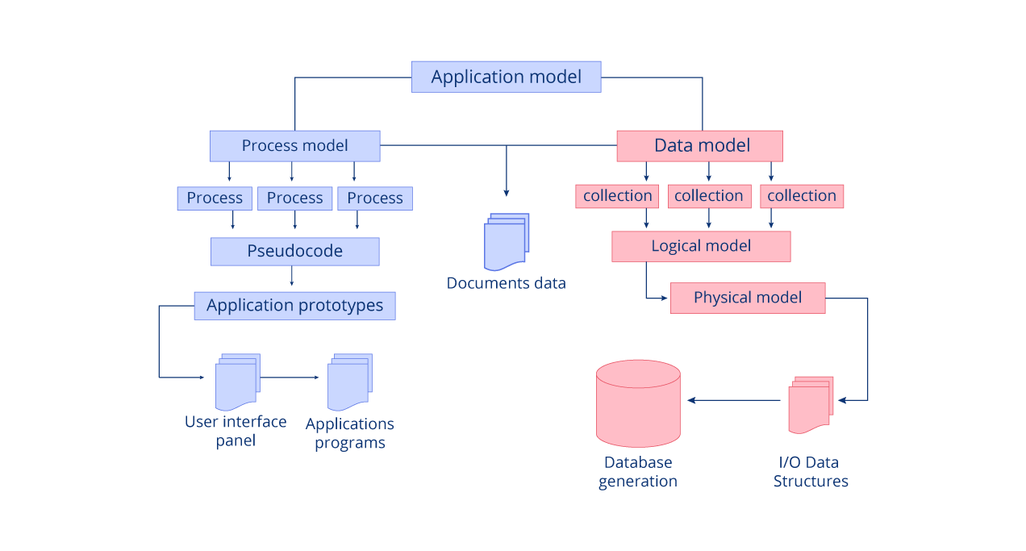
Data Modeling in MongoDB?

Slide 29
Types of Data Models in MongoDB
Documents in MongoDB play a significant role in determining which technique to use for a given set of data. In general, there are two types of MongoDB document model /data modelling:
Embedded Data Model
Reference Data Model

Slide 30
Embedded Data Model
In this case, related data is stored as a field value or an array within a single document. The main benefit of this method is that data is denormalized, making it possible to manipulate related data in a single database operation.
As a result, the efficiency of CRUD operations improves, and fewer queries are required. Consider the following document as an example:
In this set of data, we have a student with his name and some additional information. The Settings field has an object embedded in it, as well as the location. The location field is also embedded with a latitude and longitude configuration object. This student's data has been compiled into a single document. If we need to get all of this student's information, we simply run:
{ "_id" : ObjectId("5b98bfe7e8b9ab9875e4c80c"),
"StudentName" : "Ishan Jain",
"Settings" : {
"location" : "Embassy",
"ParentPhone" : 123987456
"bus" : "KAZ 450G",
"distance" : "4",
"placeLocation" : {
"lat" : -0.376252,
"lng" : 36.937389
}
}
}
db.students.findOne({StudentName : "Ishan Jain"})

Slide 31
Embedded Data Model
Pros of Embedded Model
Increased data access speed
Reduced data inconsistency
Reduced CRUD operations
Cons of Embedded Model
Restricted document size
Data duplication

Slide 32
Reference Data Model
The related data is stored in separate documents in this case, but there is a reference link between them. The sample data can be reassembled as follows:
User Document:
{ "_id" : xyz,
"StudentName" : "Ishan Jain",
"ParentPhone" : 123987456,
}
Settings Document:
{
"id" :xyz,
"location" : "Embassy",
"bus" : "KAZ 450G",
"distance" : "4",
"lat" : -0.376252,
"lng" : 36.937389
}
Although the documents are separate, they are linked by the same _id and id fields. The MongoDB data model has been normalized as a result. We must, however, issue additional queries to access information from a related document, which increases execution time.

Slide 33
Reference Data Model
Pros of Reference Data Model
Data consistency
Improved data integrity
Improved cache utilization
Improved flexibility
Faster writes
Efficient hardware utilization
Cons of Reference Data Model
Multiple lookups
Many queries are issued to achieve some operation

Slide 34
Process of Data Modeling in MongoDB
MongoDB data modelling boosts database performance, but it comes at the cost of some factors, such as:
Patterns of data retrieval
Balancing application requirements such as queries, updates, and data processing
The chosen database engine's performance characteristics
The data's own inherent structure

Slide 35
Key Considerations for MongoDB Data Modeling
When deciding on the best data model, there are several factors to consider. These aspects differ depending on the stage of the Data Lifecycle for which we are designing. These elements are as follows:
Data Creation, Modification Speed, and Frequency: Small amounts of data should be captured more quickly while maintaining consistency.
Data Retrieval Speed: The ability to retrieve small or large amounts of data for reporting and analysis.
ACID Properties: Atomicity, Consistency, Isolation, and Transaction Durability
Business scope: involves one or more departments or business functions.
Access to the Finest Grain of Data: Different data use cases may necessitate access to the finest level of detail or various levels of aggregation.

Slide 36
MongoDB Data Modeling Schema
For a given set of data, a schema is essentially a skeleton of fields and data types that each field should contain. All rows should have the same columns, and each column should contain the defined data type, according to SQL. However, MongoDB data modelling comes with a flexible Schema that doesn't require all documents to conform to the same standards.
1. Flexible Schema
In MongoDB, a flexible schema specifies that documents do not have to have the same fields or data types, and that a field can vary between documents within a collection. The main benefit of this concept is that it allows you to add new fields, delete existing ones, or change field values to a different type, resulting in a new structure for the document.
2. Rigid Schema
You may decide to create a rigid schema even though these documents may differ from one another. A rigid schema specifies that all documents in a collection have the same structure, allowing you to create document validation rules to ensure data integrity during insert and update operations.

Slide 37
MongoDB Data Modeling Schema
3. Schema Validation Levels
There are three levels of validation:
Strict: The default validation level in MongoDB is this, which applies validation rules to all inserts and updates.
Moderate: Validation rules are only applied during inserts, updates, and to existing documents that meet the validation criteria.
Off: sets the validation rules for a given schema to null, implying that no validation will be performed on the documents.
If we apply the moderate validation level using:
db.runCommand( {
collMod: "test",
validator: { $jsonSchema: {
bsonType: "object",
required: [ "phone", "name" ],
properties: {
phone: {
bsonType: "string",
description: "must be a string and is required"
},
name: {
bsonType: "string",
description: "must be a string and is required"
}
}
} },
validationLevel: "moderate"
} )
Insert the below data into a client collection.
db.clients.insert([{"_id" : 1,"name" : "Abhresh","phone" : "+91 123987456","city" : "Pune","status" : "Married"},{"_id" : 2,"name" : "Bhavesh", "city" : "Kota"}]);
The validation rules will only be applied to the document with _id 1 because it meets all the criteria.
The second document will not be validated because the validation rules do not match the issued criteria.

Slide 38
MongoDB Data Modeling Schema
4. Schema Validation Actions
There may be some documents that violate the validation rules after they have been validated. When this occurs, there is always a need to act.
MongoDB offers two actions for documents that fail to pass the validation rules:
Error: If the validation criteria are not met, this is the default MongoDB action, which rejects any insert or update.
Warn: This action will log the violation in the MongoDB log, but it will not prevent the insert or update operation from continuing.
If we try to insert a document like this:
db.students.insert( { name: "Ishan", status: "Updated" } );
Because the validation action is set to warn, despite the fact that the gpa is a required field in the schema design, the document will be saved, and an error message will be recorded in the MongoDB log.
db.createCollection("students", {
validator: {$jsonSchema: {
bsonType: "object",
required: [ "name", "gpa" ],
properties: {
name: {
bsonType: "string",
description: "must be a string and is required"
},
gpa: {
bsonType: [ "double" ],
minimum: 0,
description: "must be a double and is required"
}
}
},
validationAction: “warn”
})

Slide 39
Benefits of Using MongoDB Data Modelling
1. Higher data quality
The visual representation of requirements and business rules enables developers to anticipate what could lead to large-scale data corruption before it occurs. Data models enable developers to define rules that monitor data quality, reducing the possibility of errors.
2. Internal communication about data and data processes improves
Creating data models forces the business to define how data is generated and moved across applications.
3. Costs of development and maintenance reduce
Data modelling exposes errors and inconsistencies early in the process, making it easier and less expensive to fix.
4. Performance improves
An organised database is one that is more efficiently operated; data modelling prevents the schema from endless searching and returns results more quickly.

